Slide 1
Good Morning
Group 3

Slide 2
Topic
How dose art had do the culture and
economy of our country which reference
to gond art.

Slide 3
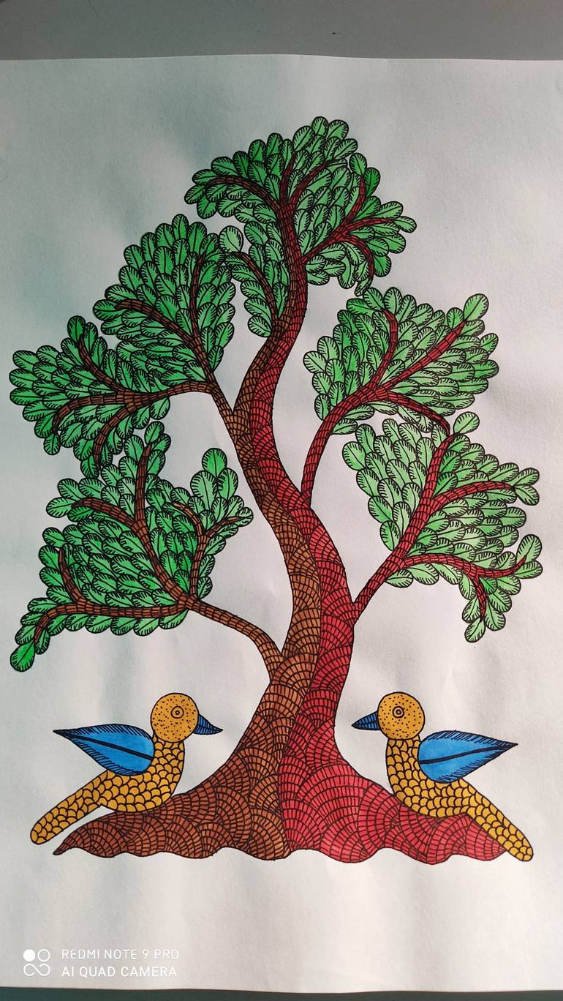
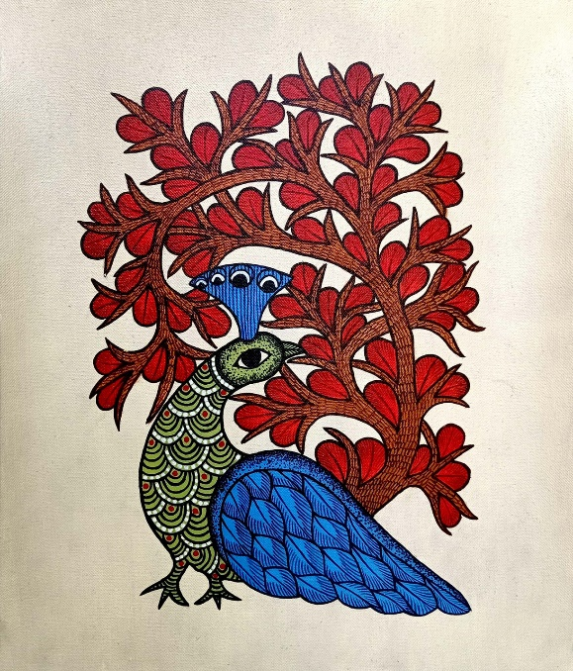
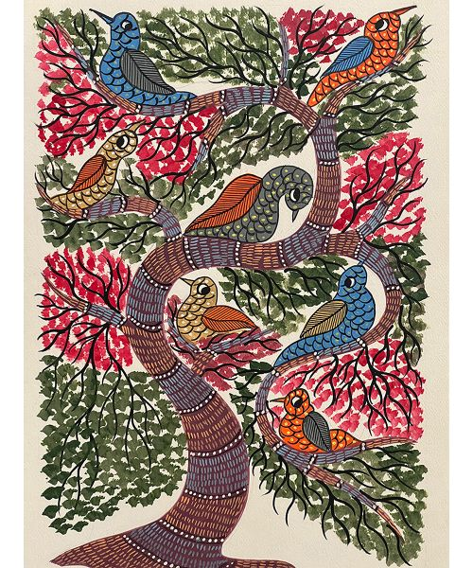
What is gond art ?
Gond art is a famous art of the Gond tribal community of central India which not only include painting but also include folk dances, songs, and performances. It is performed in per traditional way to preserve and communicate the culture of the Gond tribal community.
Gond painting is mostly made in Patangarh Village in the Dindori district of Madhya Pradesh.

Slide 4
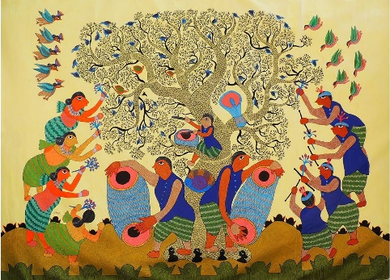
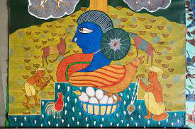
How dose gond art play an important role in the culture of India ?
1. Preserving and transmitting cultural heritage:
Gond art serves as a repository of cultural knowledge, documenting myths, legends, folklore, and traditions through various forms like paintings, murals, and songs.
2. Expressing and shaping cultural identity:
Gond art provides a platform for the Gond tribe to express their unique identity, values, and worldview.
3. Promoting social cohesion and community building:
Gond art plays a vital role in strengthening social bonds within the Gond community.
Traditionally, art creation is a collaborative process, often involving families and communities working together to create murals and tell stories.

Slide 5


How dose gond art effects the economy of the India?
Direct economic impact:
Industry growth: The Gond art market is estimated to be worth ₹100 crore (US$13 million) annually. This includes the sale of paintings, sculptures, textiles, and other art forms.
Tourism: Gond art is a popular tourist attraction, particularly in Madhya Pradesh where the Gond tribe is concentrated. Tourists spend money on travel, accommodation, food, and souvenirs, which benefits the local economy.
Indirect economic impact:
Creativity and innovation: Gond art inspires creativity and innovation in other industries, such as fashion, design, and advertising.
Education and training: Gond art programs are offered at schools and universities, providing individuals with valuable skills and knowledge.

Slide 6
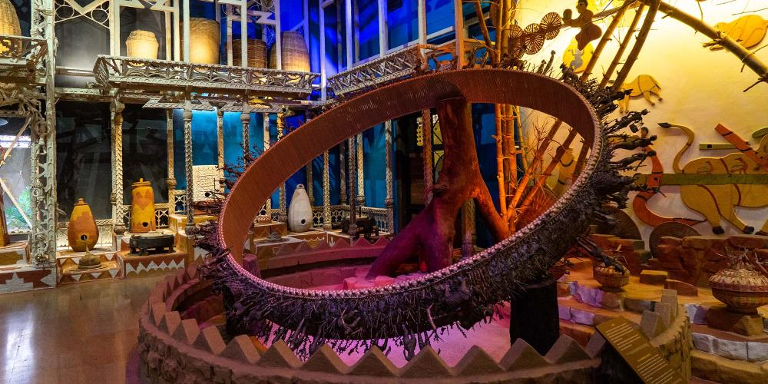
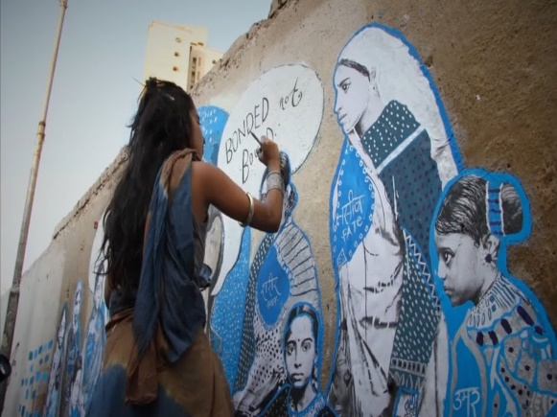
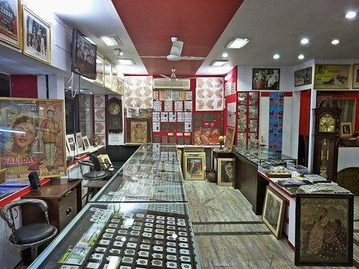

Where we can find Gond Art?
Tribal Art Museum, Bhopal: This museum houses a vast collection of Gond art, including paintings, sculptures, and artifacts. They also have regular exhibitions featuring contemporary Gond artists.
Dharavi Biennale: This contemporary art event frequently showcases Gond art installations and performances. They also have online resources and information about Gond artists.
Local art galleries: Many local galleries, particularly in Madhya Pradesh, Maharashtra, and Chhattisgarh, feature Gond art. You can find them through online searches or recommendations.
Websites: The Gond Art Project website has a rich collection of images, information, and artist profiles. Other websites like Saffronart and India Arts Portal also offer curated collections of Gond art.

Slide 7
Group Members
Gangadiaya Manus
Jadhav Viraj
Jangid Kartik
Khairnar Atharva
Landge Mayuresh
Mahajan Aarush
More Yuraj
Patil Patik
Patil Vedant
Radadiya Om

Slide 8
Thank You!!!

